Slide 1
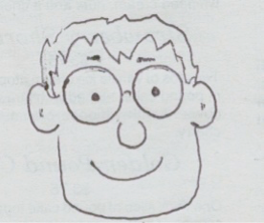
GTDT - a small desktop amp
EE 333
Aug. 23, 2020
Gary Tuttle

Slide 2
Abstract
The goal of this project is to design an “un-complicated” low-power stereo amplifier that can be built by members of the Audio Club. Many of these students are sophomores or juniors — just taking EE 201 and EE 230 — and do not have extensive circuit experience. The idea is to have a design that is “uncomplicated” in the sense that an EE 230 student would understand the basic principles. The design should use minimal parts and require minimal skills to build the circuit on perf board or a PCB. Even though the design is simple, the amp should produce “decent” sound. In order to meet the primary goal of simplicity, the amplifier will: a) work off of a single supply, b) use op amps for voltage gain, c) use class B push-pull output stages (with no biasing), d) not have any external switches or knobs — just connectors for power in, music in, and music out. The final design will be buildable on a perf board or printed circuit board and will include an enclosure and all of the necessary connectors.

Slide 3
Specifications
The circuit will work off of a single 15-V power supply regulated with a simple linear regulator, with several options for input power: 12-VRMS “wall plug” transformer, an 18-V DC wall plug”, or two 9-V batteries.
The input to the circuit will be a standard line-level analog stereo audio signal. The output will drive a set of small stereo speakers.
The voltage amplification will be provided by non-inverting op-amp circuits with gain of 16 (= 24 dB).
Output current will be supplied by class B amplifier stages. (There will be no extra biasing to make A-B outputs. The circuit will rely on feedback to minimize cross-over distortion.)
The outputs should be able to drive a speaker load of 4 Ω and provide an output power of at least 2 W per channel.
Total Harmonic Distortion at 1 kHz should be less than 1%.
The output transistors should not require heat sinks.
No on-off switch or volume control will be provided in the basic circuit. (These can be added as later options.)
The input will be capacitively coupled to protect input devices (cell phones, etc.)

Slide 4
Testing plan
Power supply voltage — check specifically for the 15-V output of the regulator using 12-VRMS transformer, 18-V DC, and 2 9-V batteries.
Regulator drop out. How low can the input supply voltage drop before the regulator ceases to function properly?
DC voltages in the circuit, to make certain that the single-supply approach is working properly.
Maximum sinusoidal output amplitude before clipping, both unloaded and with a 4-Ω load (simulating a speaker) at the output.
Frequency response of the amplifier gain from 1 Hz to 100 kHz, checking for the low-frequency roll-off and for any variations in the gain over the audio frequency range. Frequency response will be measured with the output unloaded and then again with loaded with a 4-Ω load test resistor.
Total Harmonic Distortion of the output under fully loaded conditions at frequency of 1 kHz.
Finally, we will do a qualitative heat dissipation measurement — basically a “finger test” of the temperature of the output BJTs when running under full-load conditions for an extended time. Here we are checking to see if a heat sink might be necessary.

Slide 5
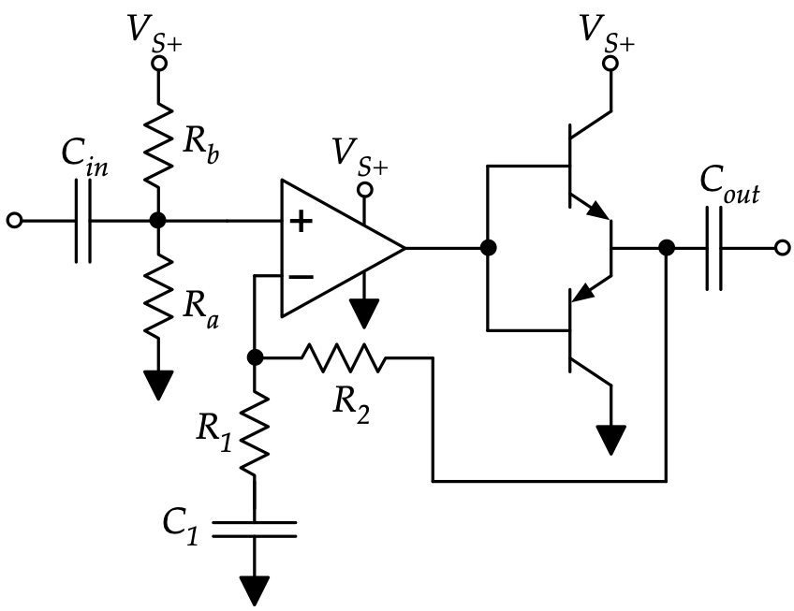
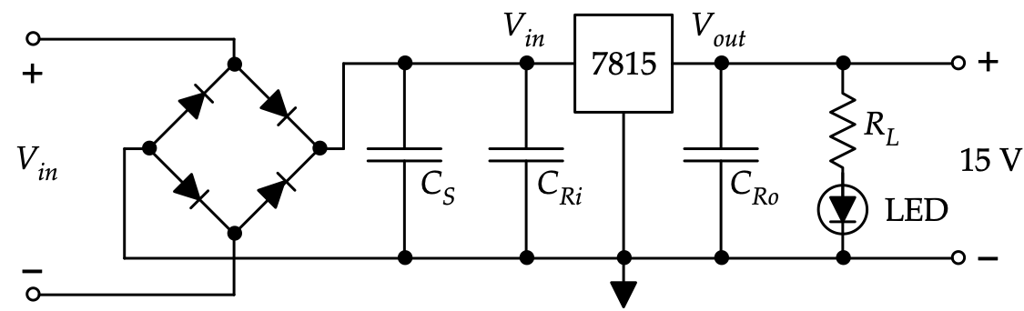
Preliminary schematics
Amplifier section (one channel)
power section

